Slide 1
Design and Analysis of Algorithms
Medians and Order Statistics (Ch9)

Slide 2
Simple Review
Counting sort
  How if there are 17 elements not greater than x in A?
    Put the last one in position 17, the penultimate one in position 16,…
  If k = O(n), then counting sort takes Θ(n) time.
Radix sort
  Sort on least-significant digit first with auxiliary stable sort.
  Θ(d T(n)), if we use counting sort and d is constant, Θ(n)
Bucket sort
  Divide the interval [0,1) into n equal-sized subintervals, or bucket, and then distribute the n input number into the buckets.
  Θ(n) under uniform distribution

Slide 3
Design and Analysis of Algorithms
Medians and Order Statistics
Topics:
Order Statistics
Expected linear time selection
Worst-case linear time selection
Notes:
Median：中部, 当中, [数学] 中线, 中值

Slide 4
Today
Median and order statistics
Two O(n) time algorithms:
  Randomized: similar to Quicksort
  Deterministic: quite tricky
Both are examples of divide and conquer

Slide 5

Order Statistics
Order Statistics:
  The i th order statistic of a set of n elements is the i th smallest element.
Medians
  The “halfway point” of the set.
  We use “the median” to refer to the lower median.
Select the ith smallest of n elements (the element with rank i).
  Minimum: i = 1
  Maximum: i = n
  Median:
How fast can we solve the problem?
  O(n) for min or max.
  O(n lg n) by sorting for general i.
  O(n lg i) with heaps.
Next we will see how to do it in O(n) time.

Slide 6
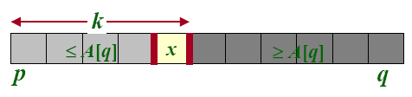
Randomized algorithm for finding the i th element
Divide and conquer approach
Main idea: PARTITION
If i < k, recurse on the left
If i > k. recurse on the right
Otherwise, output x

Slide 7
RANDOMIZD SELECT
RANDOMIZD SELECT
RANDOMIZED-SELECT(A, p, r, i) 1 if p = r 2 then return A[p] 3 q ← RANDOMIZED-PARTITION(A, p, r)// as used in quicksort 4 k ← q–p+1 // k = rank(A[q]) 5 if i = k // the pivot value is the answer 6 then return A[q] 7 if i < k 8 then return RANDOMIZED-SELECT(A, p, q–1, i) 9 else return RANDOMIZED-SELECT(A, q+1, r, i–k)

Slide 8
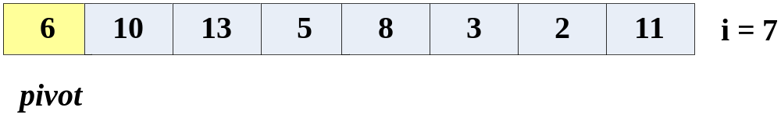
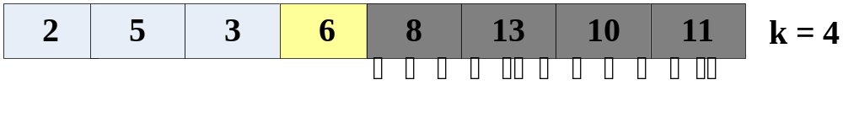
RANDOMIZD SELECT Example
Select the i = 7th smallest:
Partition:
Select the 7 -4 = 3rd smallest recursively

Slide 9
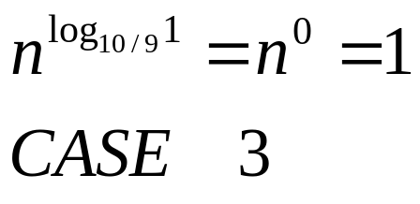
Analysis
What is the worst-case running time?
Unlucky:
T(n) = T(n - 1) + Θ(n)
= Θ(n²)
Recall that a lucky partition splits into arrays with size ratio at most 9:1
What if all partitions are lucky?
Lucky:
T(n) = T(9n/10)+Θ(n)
= Θ(n)
Notes:
9n/10 <= 91/100n

Slide 10
Summary of randomized order-statistics selection
Works fast: linear expected time.
Excellent algorithm in practice
But, the worst case is very bad: Θ(n²)
Q. Is there an algorithm that runs in linear time in the worst case?
A. Yes, due to [Blum-Floyd-Pratt-Rivest-Tarjan’1973]
IDEA: Generate a good pivot recursively.

Slide 11
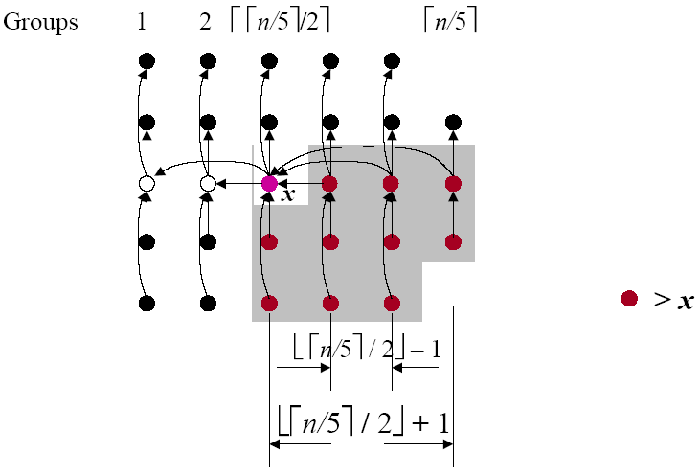
Pictorial Analysis of Select

Slide 12

Worst-Case Linear-Time Selection
SELECT(A, i)
1. Divide n elements into groups of 5, plus extra
2. Find medians of each group by insertion sort.
3. Find median x of the medians by calling SELECT() recursively
4. Partition the n elements around pivot x. Let k = rank(x)
5. if (i = k) then return x
if(i < k) then call SELECT() recursively to find i-th
smallest element in left partition
else call SELECT() recursively to find (i – k)-th smallest
element in left partition

Slide 13
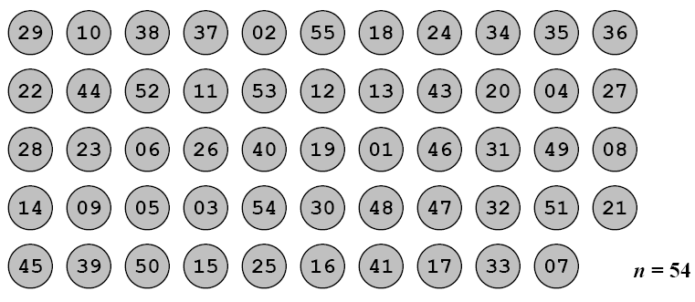
Partition
Partition().
→ -Divide n elements into groups of 5 elements each, plus extra.

Slide 14
Partition
Partition().
→ -Divide n elements into groups of 5 elements each, plus extra.
→--Find medians of each group by insertion sort.

Slide 15
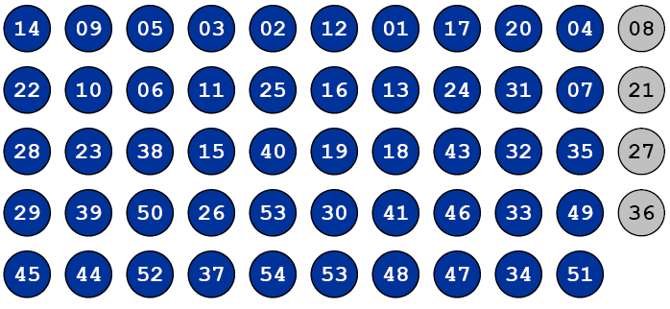
Partition
Partition().
→ -Divide n elements into groups of 5 elements each, plus extra.
→--Find medians of each group by insertion sort.

Slide 16
Partition
Partition().
→ -Divide n elements into groups of 5 elements each, plus extra.
→--Find medians of each group by insertion sort.
→--Find x=“median of medians” by SELECT () ON medians.
Median of
medians

Slide 17
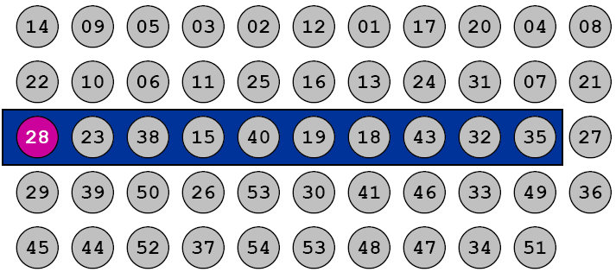
Partition
Partition().
→ -Divide n elements into groups of 5 elements each, plus extra.
→--Find medians of each group by insertion sort.
→--Find x=“median of medians” by SELECT () ON medians.
Median of
medians

Slide 18
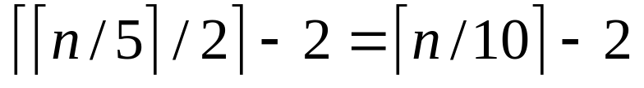
Selection Analysis
Crux of proof:
→ -- At least half of medians found in step2 > x, except for …
>>at least medians > x
Median of
medians
Notes:
Crux：关键点基本的、中心的或关键的一点或特征：

Slide 19
Selection Analysis
Crux of proof:
→ -- At least half of medians found in step2 > x, except for …
>>at least medians > x
Median of
medians
38
40
43
32
35

Slide 20
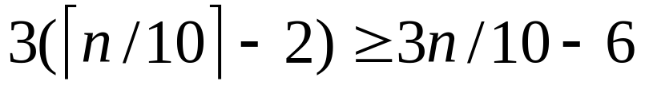
Selection Analysis
Crux of proof:
→ -- At least half of medians found in step2 > x, except for …
>>at least medians > x
→ --At least elements > x
Median of
medians
38
40
43
32
35
38
40
43
32
35
38
40
43
32
35

Slide 21
Selection Analysis
Crux of proof:
→ -- At least half of medians found in step2 > x, except for …
>>at least medians > x
→ --At least elements > x
→ --At least 3n/10 – 6 elements < x
09
03
12
01
Median of
medians
10
11
16
13
23
15
19
18

Slide 22
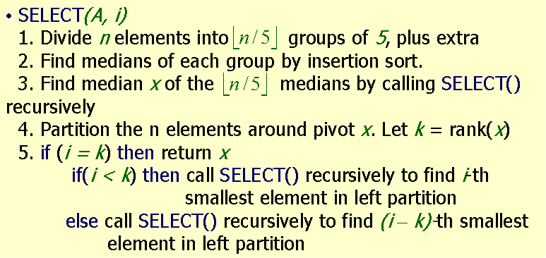
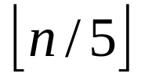
Selection Analysis
Crux of proof:
→ -- At least half of medians found in step2 > x, except for …
>>at least medians > x
→ --At least elements > x
→ --At least 3n/10 – 6 elements < x
⇨ SELECT() called recursively (step 5) with at most n – (3n/10 - 6) = 7n/10 + 6 elements in the worst case, regardless of which partition is used.
Algorithm analysis
-- Step 1,2, and 4 take O(n) time,
-- Step 3 takes time T( ), and
-- Step 5 takes time at most T(7n/10 + 6)

Slide 23
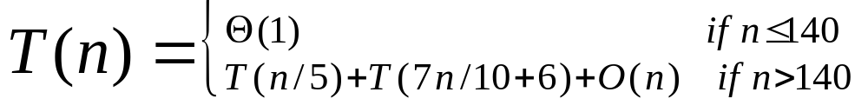
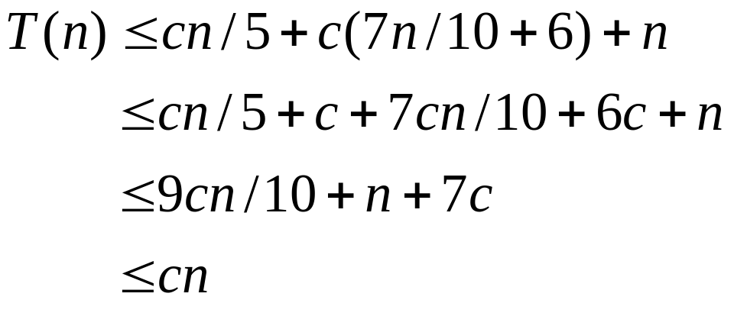
Selection Analysis
Claim: Thus after partitioning around x in step 4, step 5 will call SELECT() on at most 70% of the elements
Claim: T(n) ≤cn
--Base case: n ≤140
--Inductive hypothesis: assume true for 1,2,…,n-1
--Induction step: for n > 140, we have:
⬅if we choose c such that 7c+n≤cn/10
e.g. true for c = 20 if n > 140

Slide 24
Homework
9.1-1

